Slide 1
EXTRA BIG FACTORIALS

Slide 2
Problem statement
Calculate and print the factorial of a given integer where 1 <= n <= 100

Slide 3
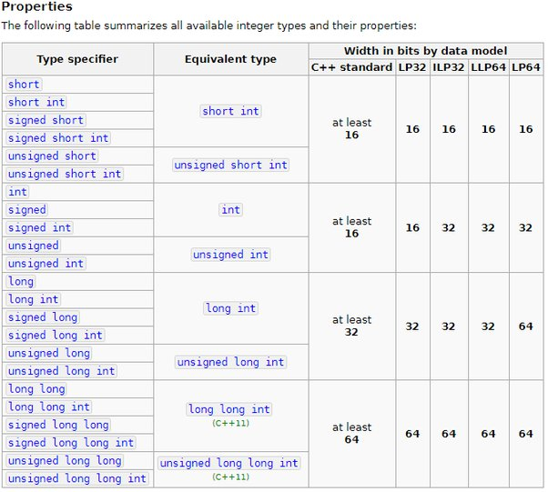
64 bits
Max value :
744, 073, 709, 551, 615
Factorial of 18 :
6, 402, 373, 705, 728, 000

Slide 4
Solution
MULTIPLICATION
Number 1
Number 2
EXTRABIGFACTORIALS
RESULT

Slide 5
Multiplication done with strings
Multiply each digit within number 1 with each digit belonging to number 2.
Compute the sum, add the carry (if any) from previous operations.
If the number is bigger than 10, the first digit should be our result and the new carry is the second digit
(ex : 16 => 6 is the result and 1 is the carry)
Compute the resulting index being the sum of the index of number 1 and the index of the digit within number 2.

